Slide 1



Digits n Data
DIGITS N DATA
SQL PROJECT
Presented by: Ankan Bandyopadhyay

Slide 2
INTRODUCTION:
CHALLENGE:
TO CRAFT SQL QUERIES TO EXTRACT INSIGHTS FROM THE 92.7 BIG FM RADIO NETWORK DATABASE.
TABLES:
STATIONS
HOSTS
SHOWS
PARTNERSHIPS
SHOWPARTNERSHIPS
AWARDS
ONLINEPRESENCE

Slide 3
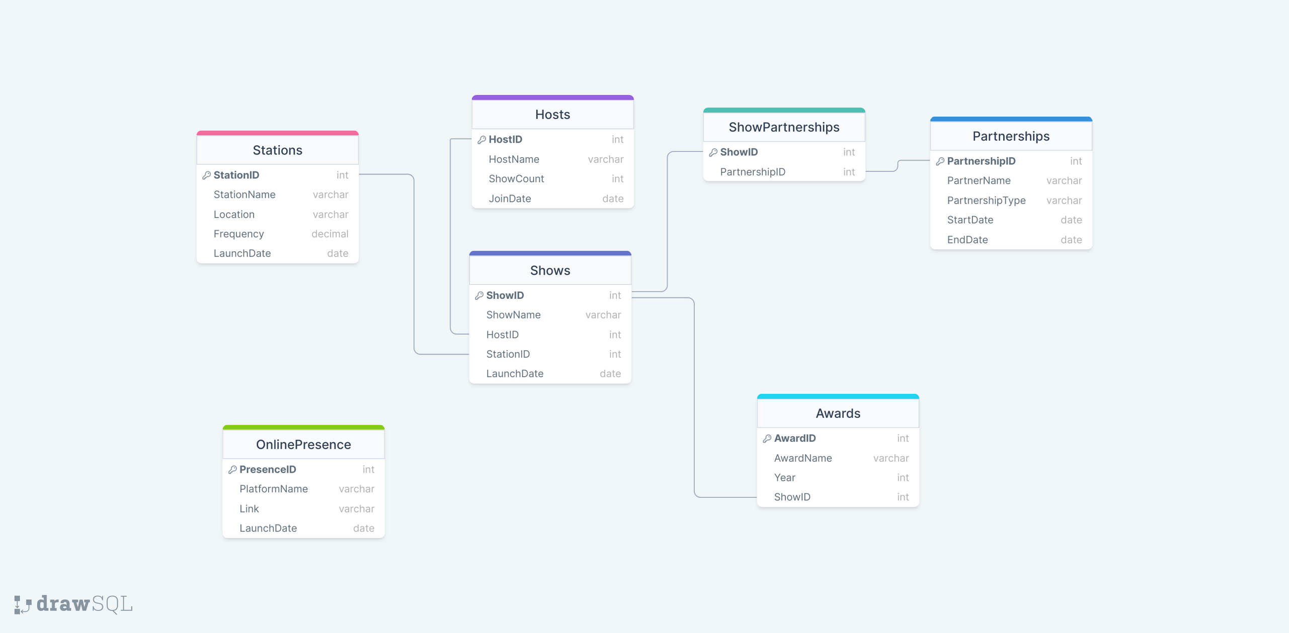
ER Diagram: https://drawsql.app/teams/ankan-bandyopadhyay/diagrams/big-fm-sql-challenge
Oracle Schema: https://drive.google.com/drive/folders/1v2KfLtyTYWAe15Y-r4dbnteeix-Y8yZb?usp=drive_link

Slide 4
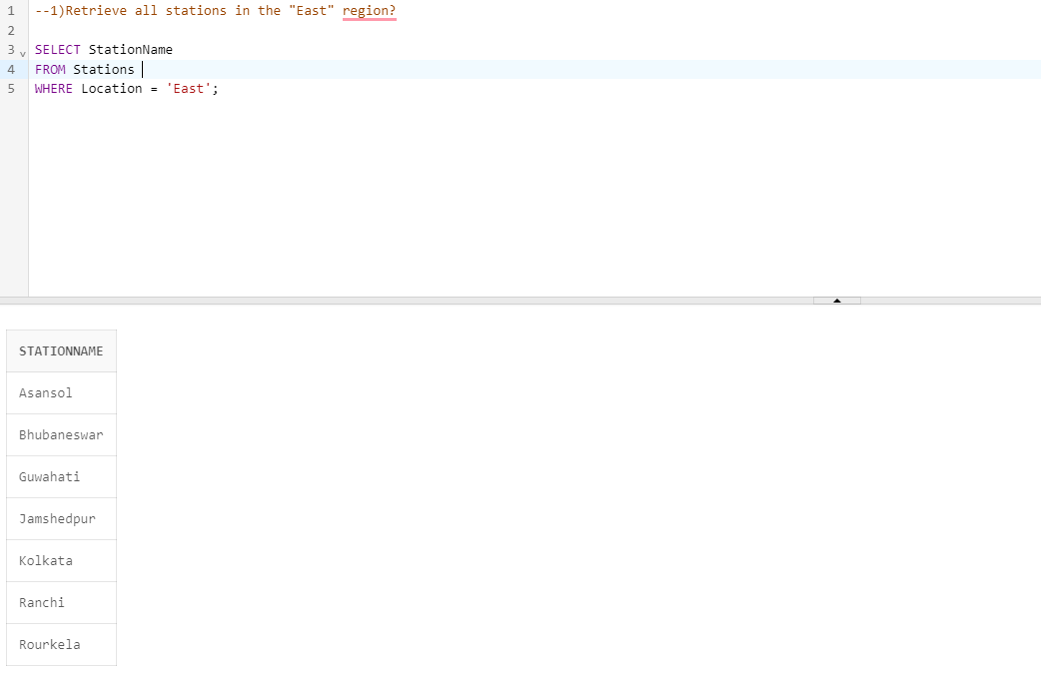

Slide 5
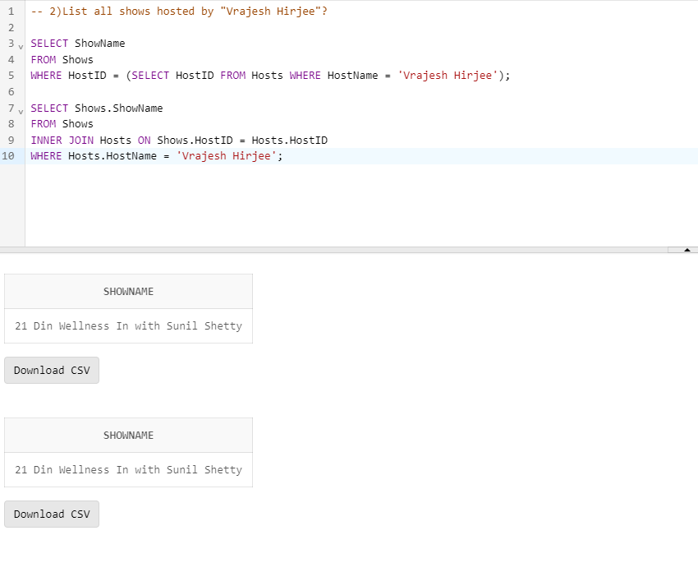

Slide 6
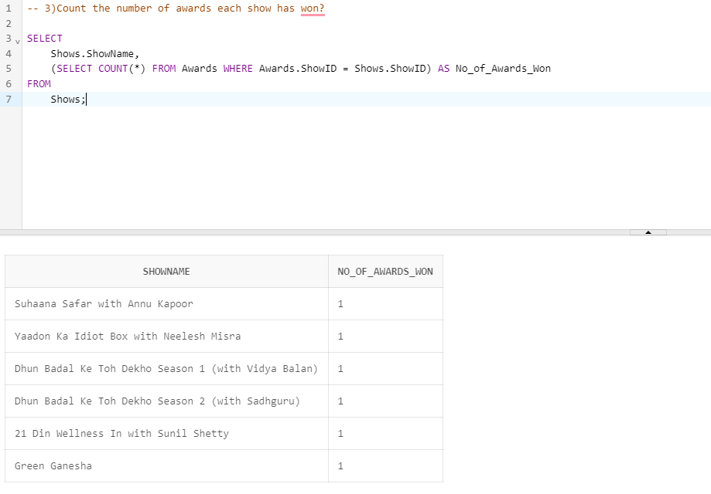

Slide 7
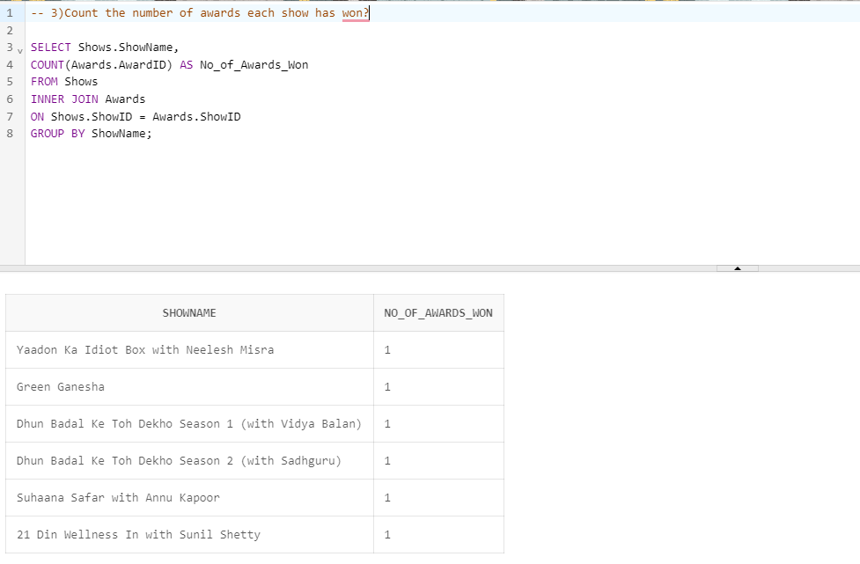

Slide 8
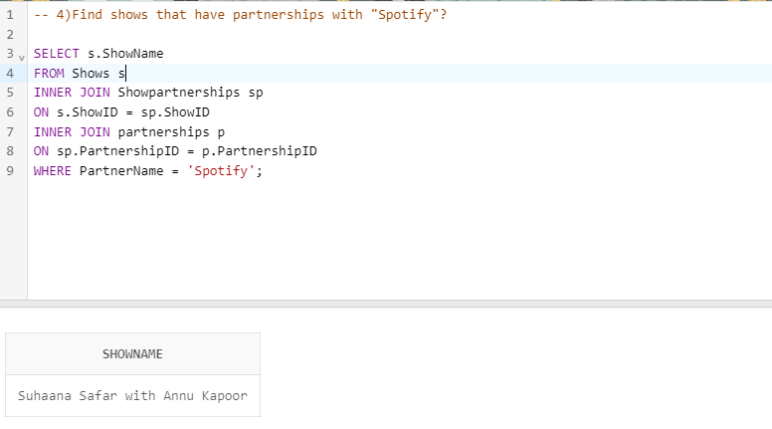

Slide 9
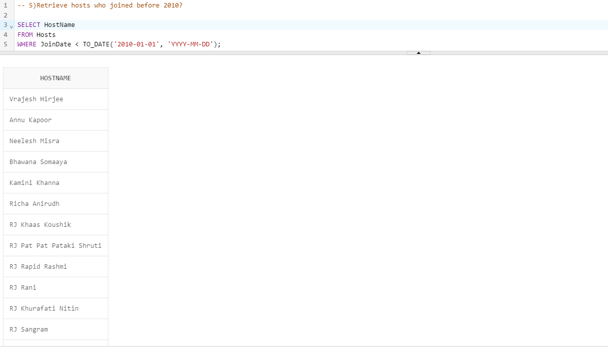

Slide 10
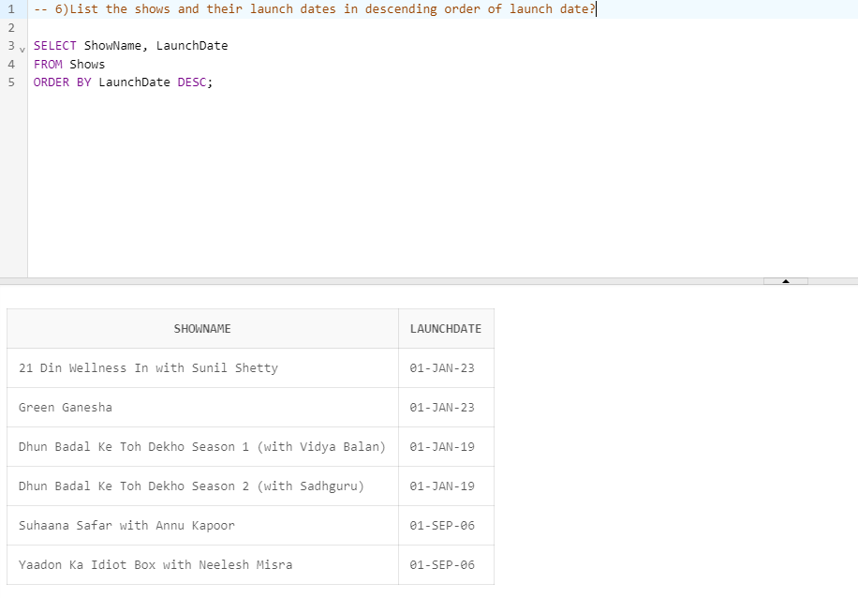

Slide 11
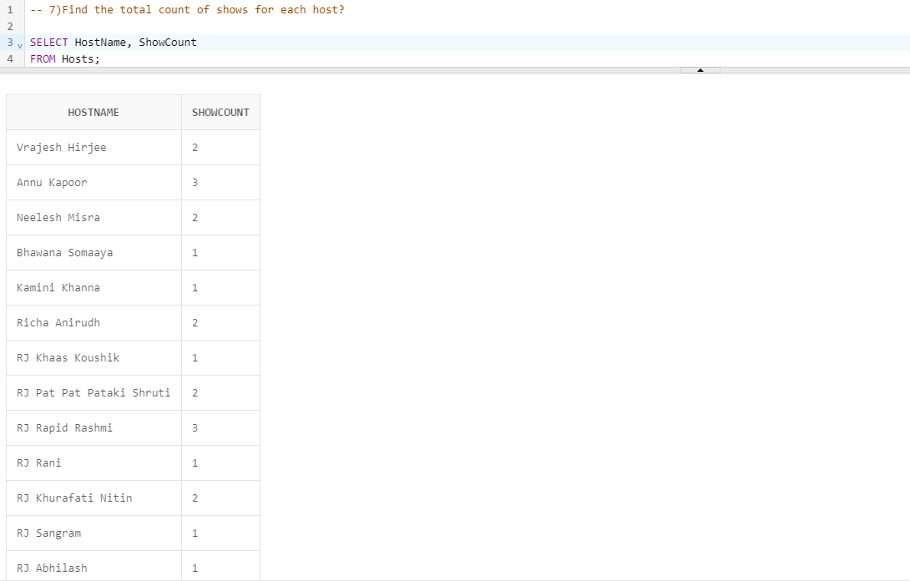

Slide 12
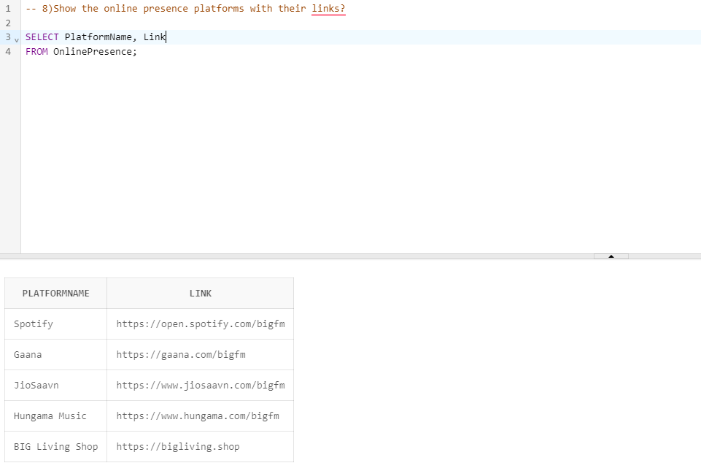

Slide 13
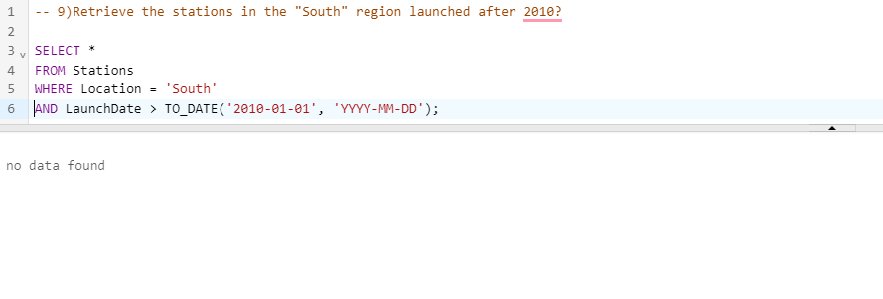

Slide 14
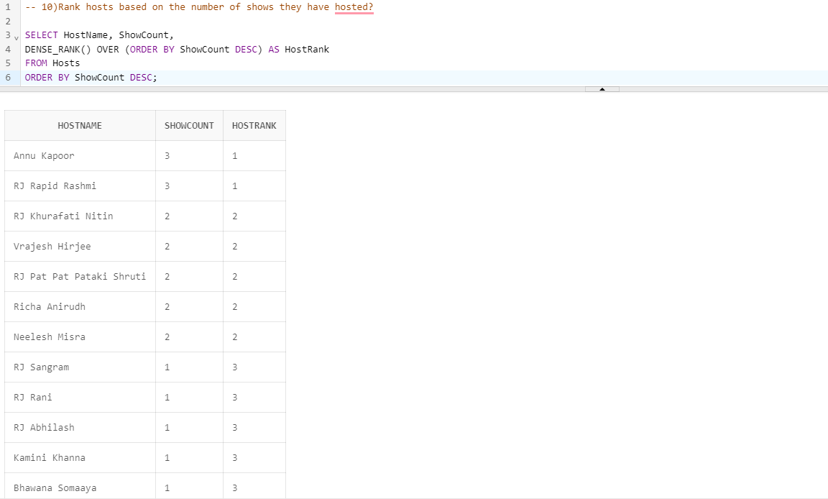

Slide 15


Thank You!
Ankan Bandyopadhyay

